Slide 1




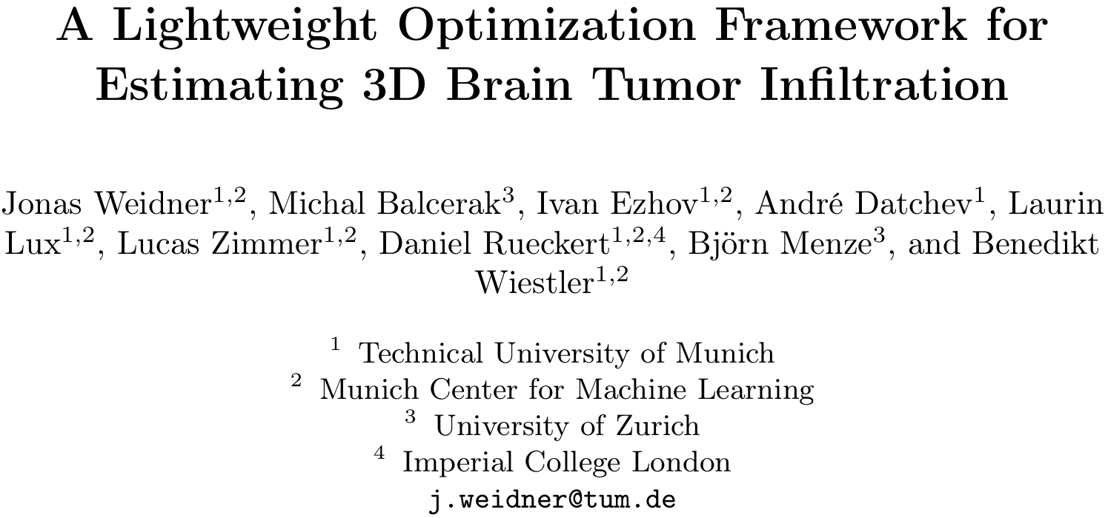

A Lightweight Optimization Framework for Estimating 3D Brain Tumor Infiltration
CMMCAWorkshop

Slide 2




Typical Treatment
Diagnose MRI
days
Surgery
weeks
Chemotherapy
Radiotherapy
months

Slide 3
Typical Treatment
Diagnose MRI
days
Surgery
weeks
Chemotherapy
Radiotherapy
months

Slide 4
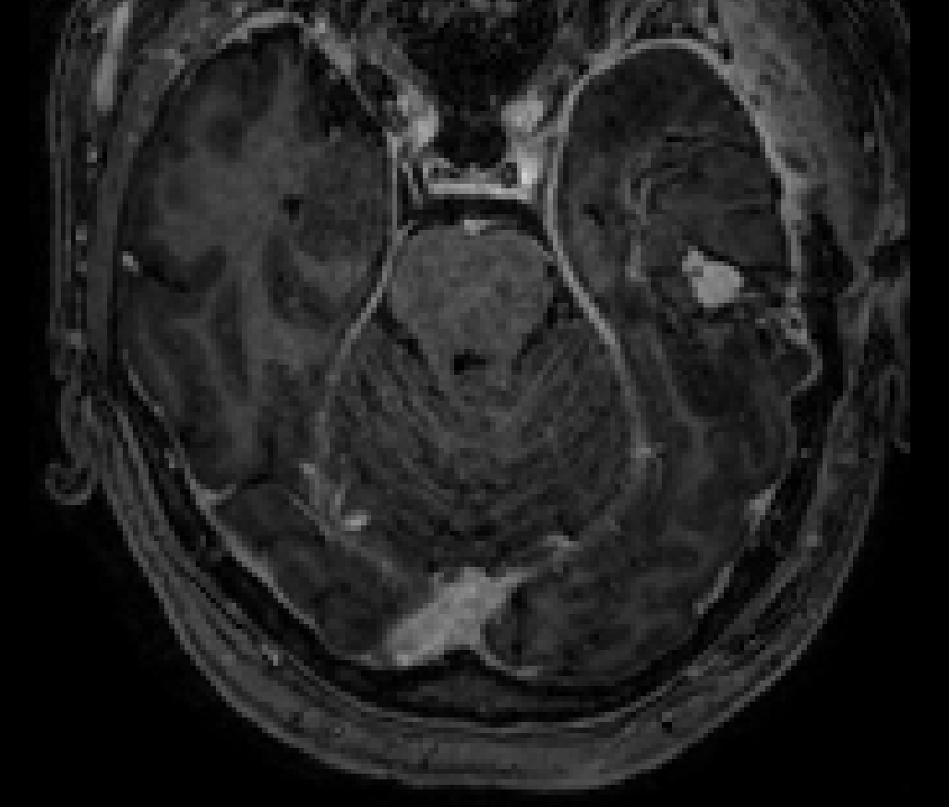
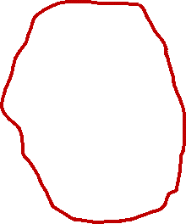
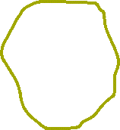

Potential Improvement
Low tumor concentration not visible in MR
Standard: Distance based homogeneous irradiation
Estimate tumor concentration -> Model
1.5 cm
Typical radiation
Proposed radiation
Resection cavity

Slide 5
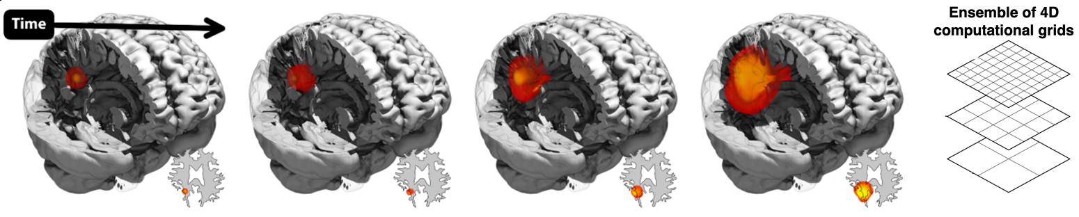
Current Approaches
Neural network (based on NN-UNet)
Physics-constrained neural network
Numerical physics simulation
Static grid discretization

Slide 6
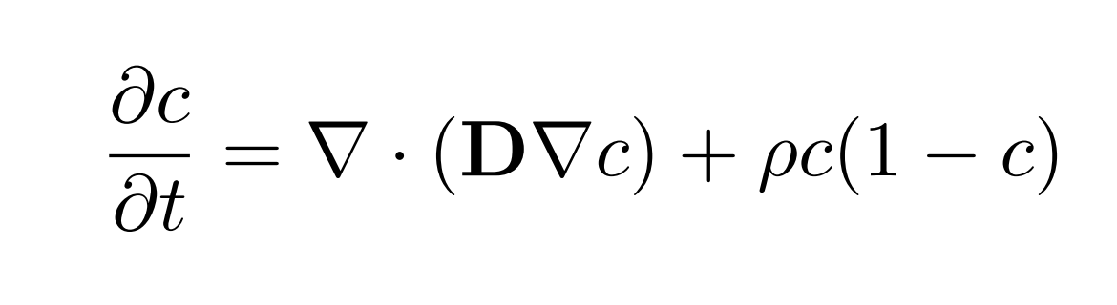




Tumor Model
(x, y, z)
Concentration change
Growth
Diffusion
c
c
t
x
Notes:
3. Things
- What is important in modeling?
Logistic growth
Brownien motion Diffusion
Tissue dependent D
Necrotic…
Mass effect…
Assumptions. Issotropic tissue…

Slide 7
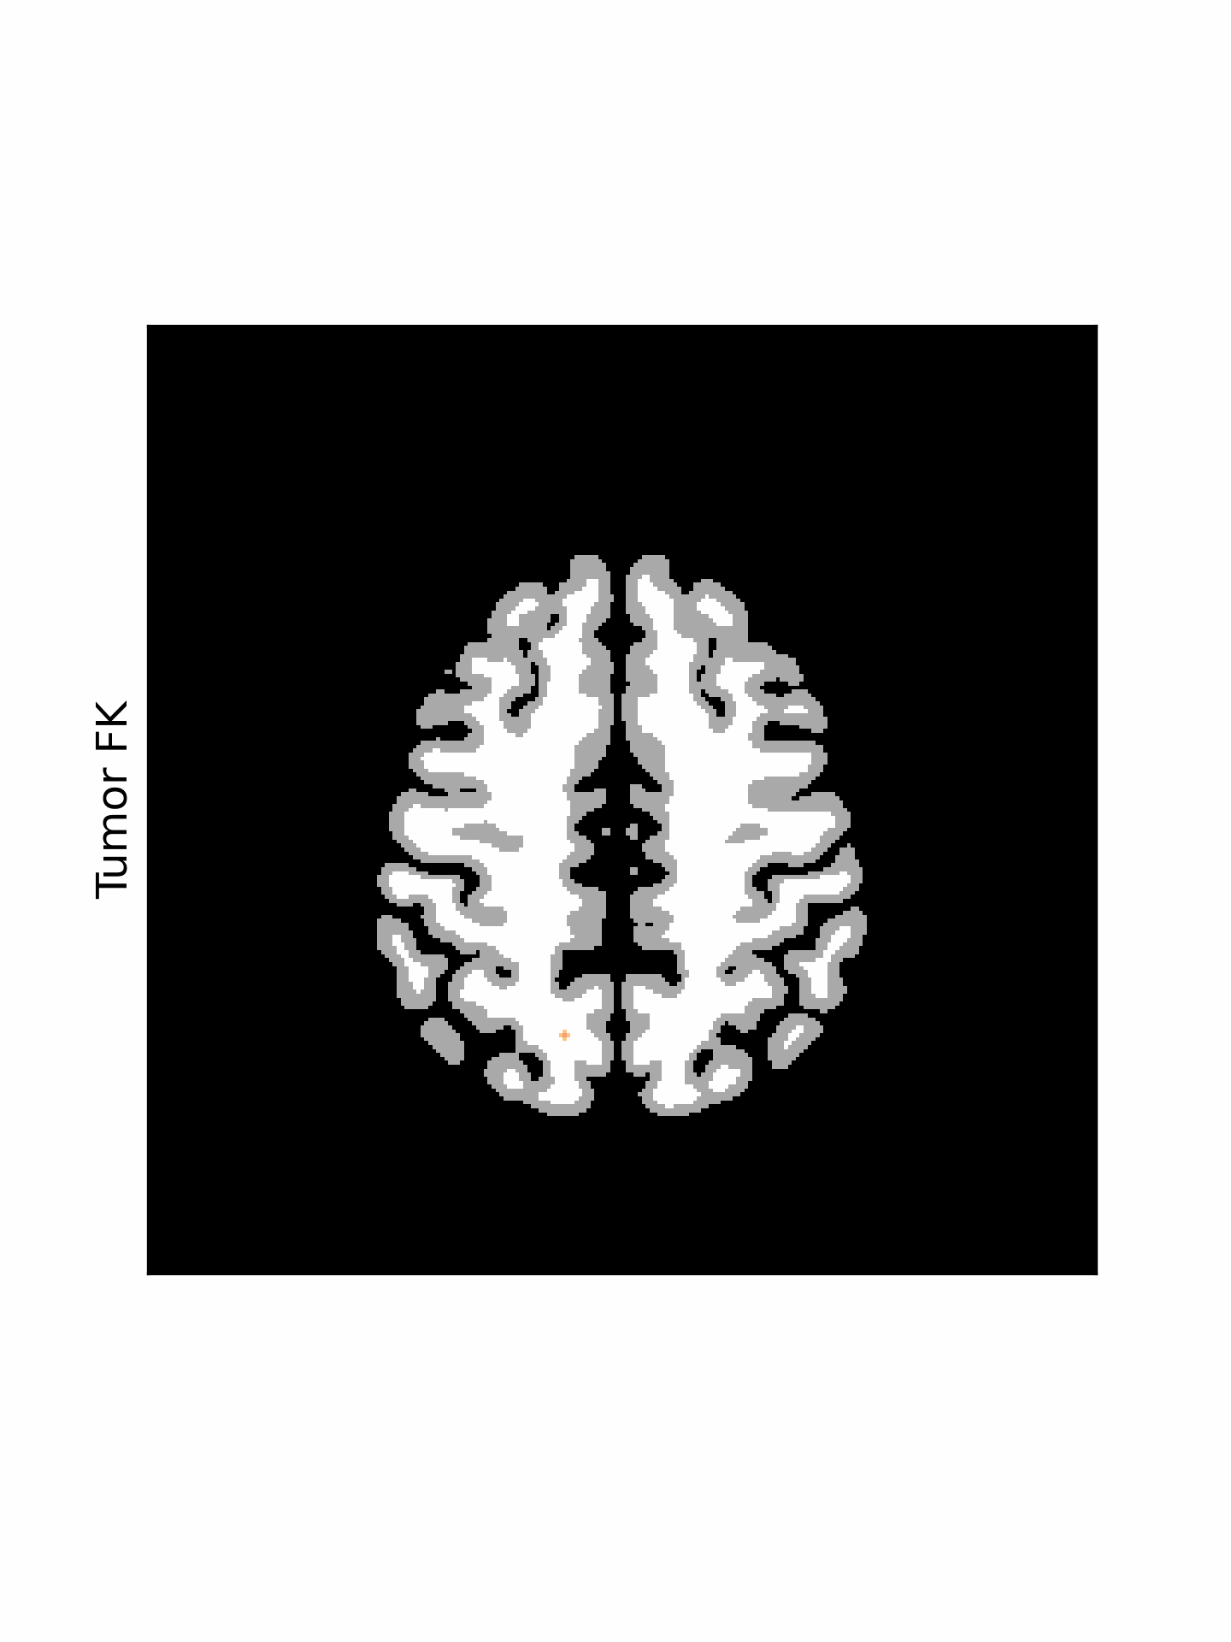
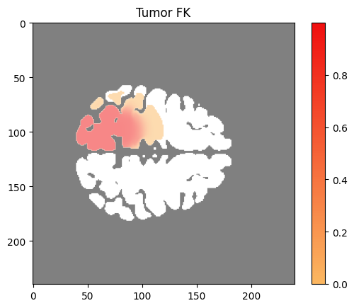
1
Tumor
Concentration
0
White Matter
Grey Matter
Notes:
TODO say that it is isotrop - DTI

Slide 8
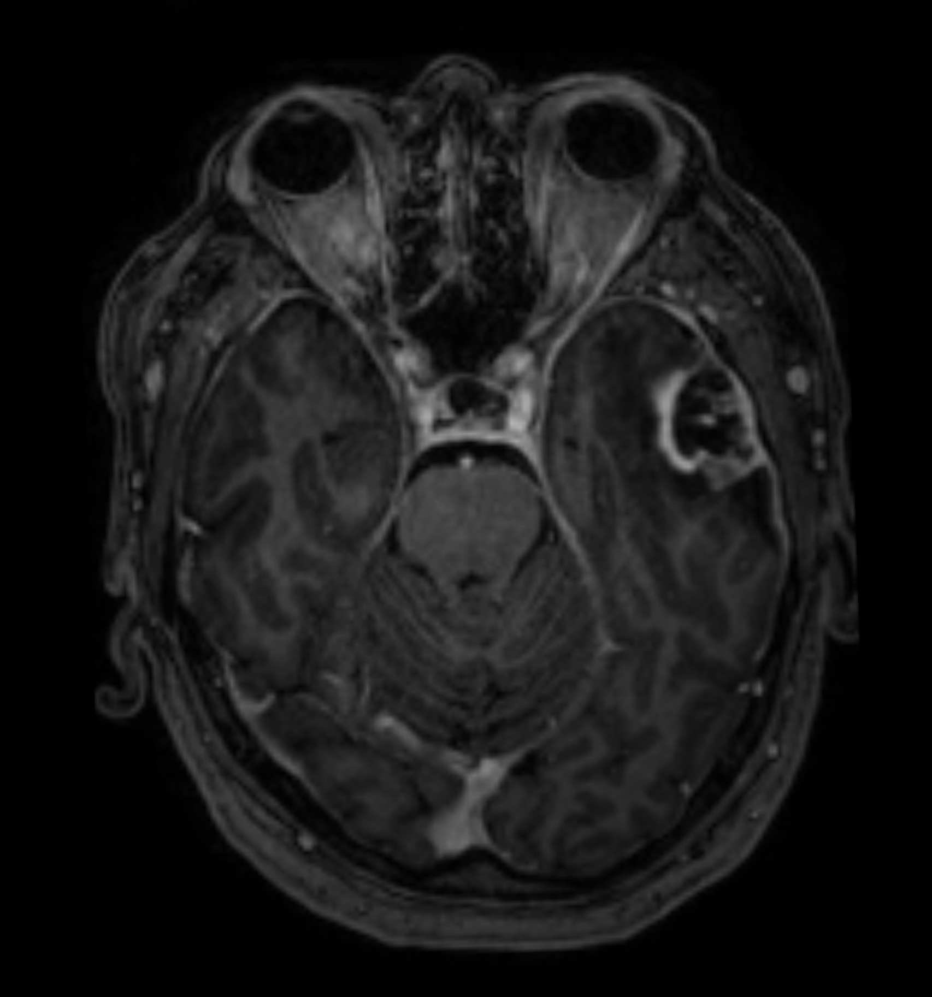
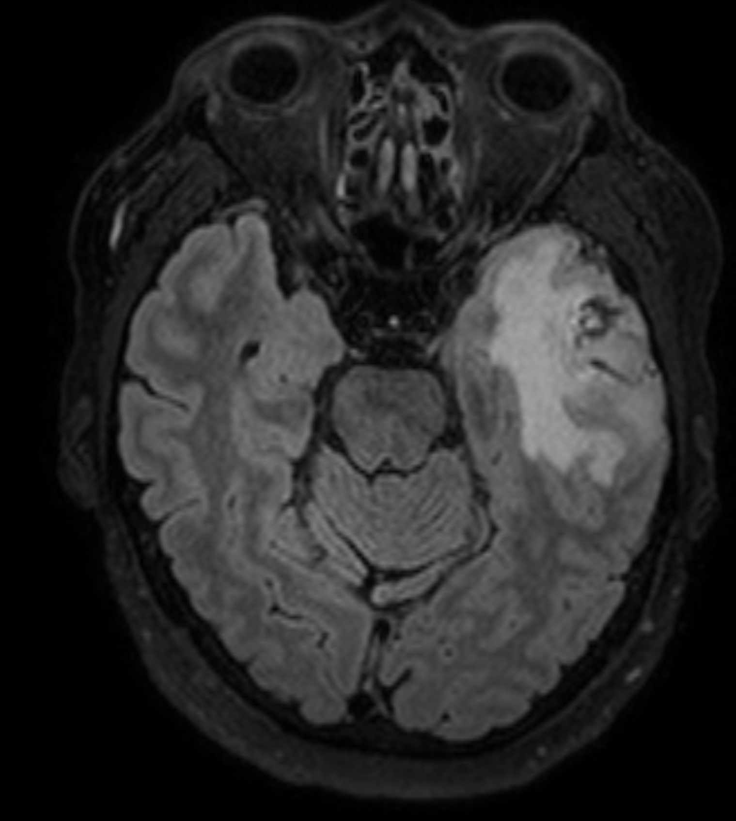

Imaging
T1 contrast - core
T2 FLAIR - edema
Notes:
What is Core:
What is Edema: liquid…
Highly
Single Time Point. Still physically plausible
Low concentration not visible

Slide 9
Imaging Model
Tumor Concentration
x
T1c Threshold
Tumor Concentration
FLAIR Threshold
Location - x

Slide 10
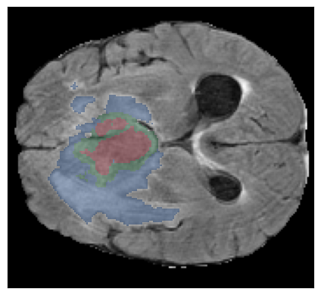
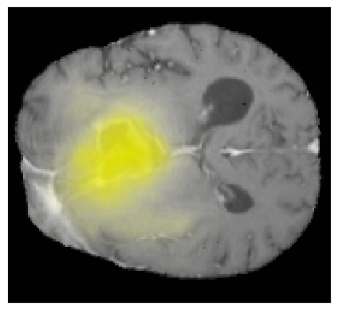
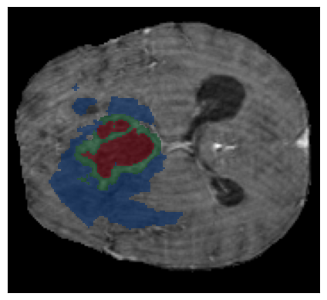
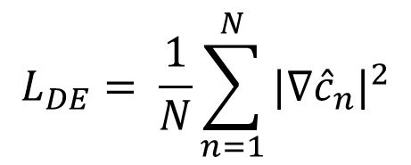
Our Approach
Tumor Concentration
Flair
Dirichlet Energy
T1c
Data Loss
Regularization
$$L_{DE}= \frac{1}{N}\sum_{n=1}^{N}{{|∇{\hat{c}}_{n}|}^{2}}$$
Optimization

Slide 11
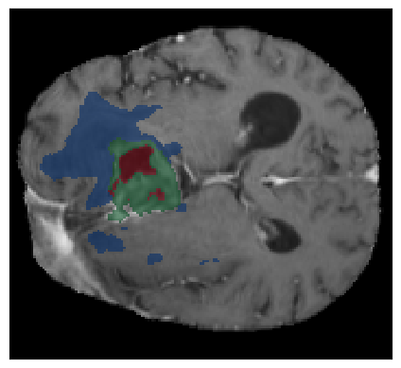
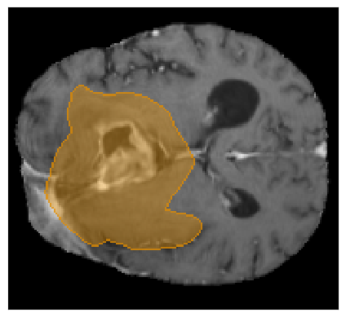
Evaluation
Predicted
Tumor Concentration
Personalized
Clinical Target Volume
Tumor Recurrence
Threshold
Evaluation
Recurrence
Edema
Enhancing
Necrotic

Slide 12
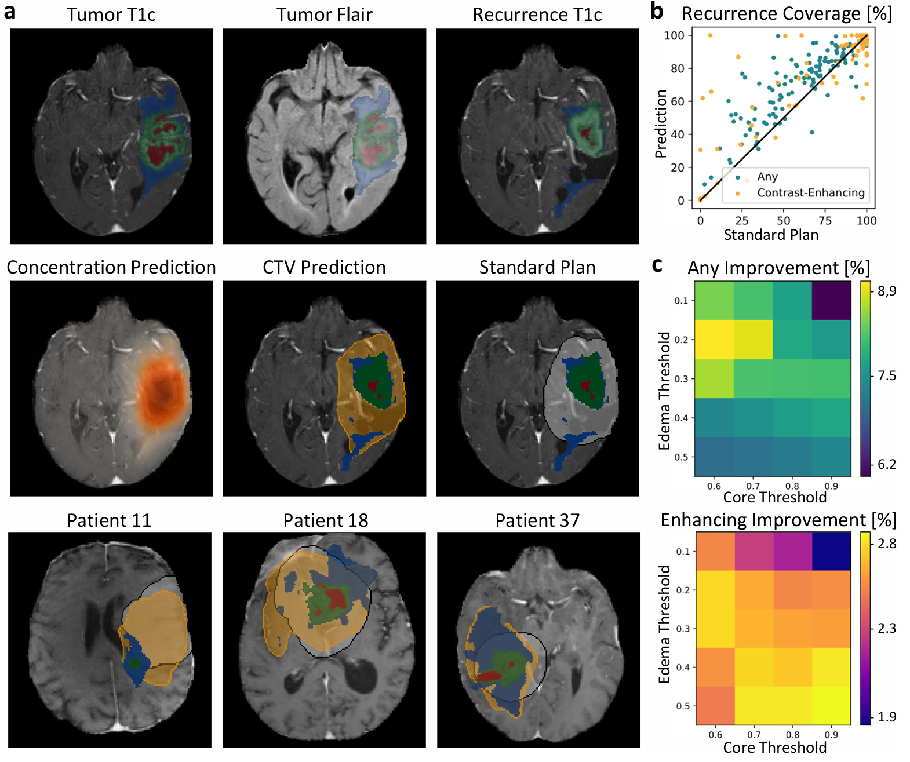
Example
Recurrence
Edema
Enhancing
Necrotic

Slide 13
Examples – Recurrence Prediction
CTV Prediction
Recurrence
Ours
Standard Plan
Edema
Enhancing
Necrotic

Slide 14
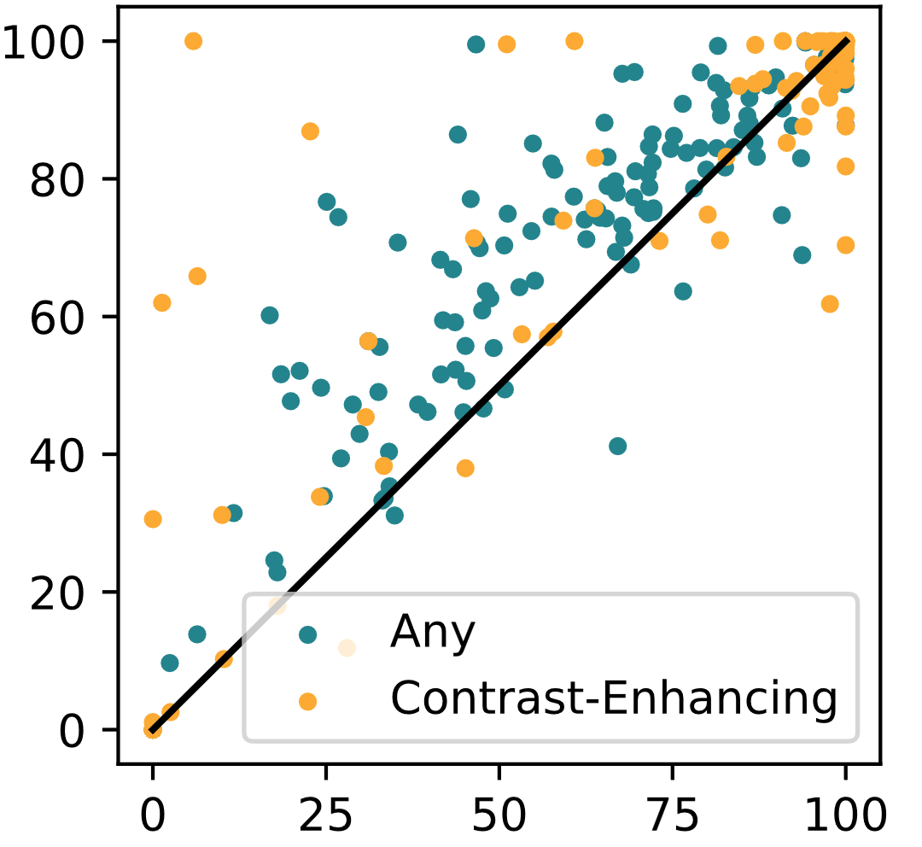
Recurrence Coverage
Personalized Plan Coverage [%]
Any recurrence
Enhanced recurrence
Standard Plan Coverage [%]
Notes:
Any recurrence

Slide 15
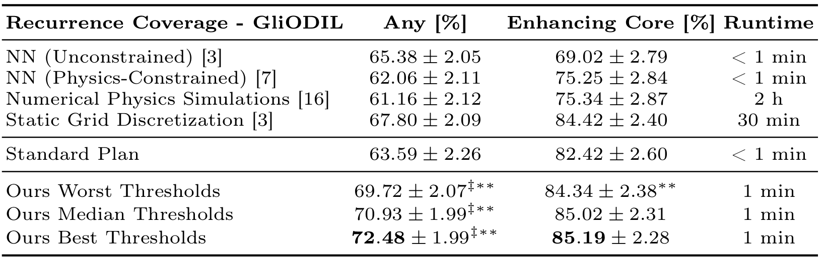
Recurrence Coverage

Slide 16
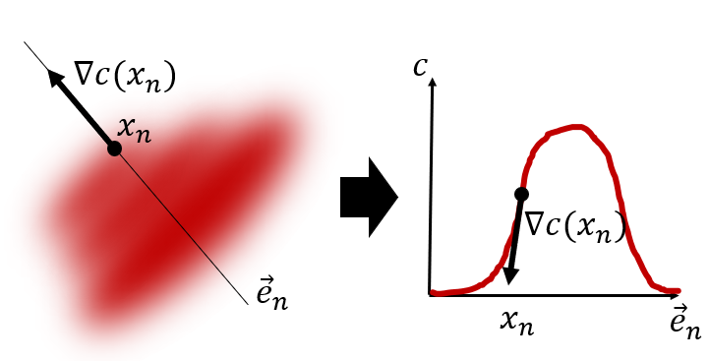
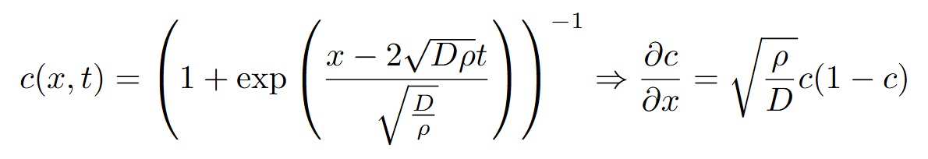
Extension – Traveling Wave Loss
Analytical solution:
Loss:
Notes:
Todo name eq

Slide 17
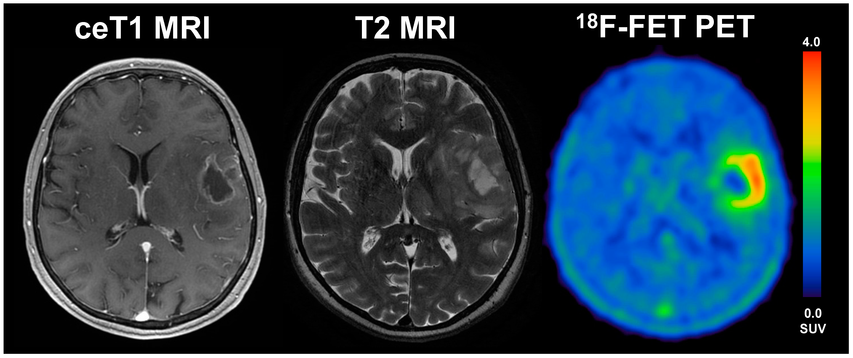
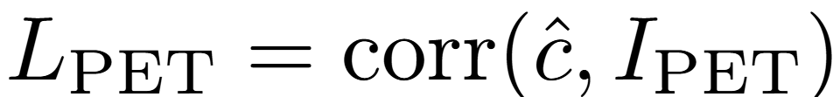
Extension – FET-PET Loss
Loss:

Slide 18
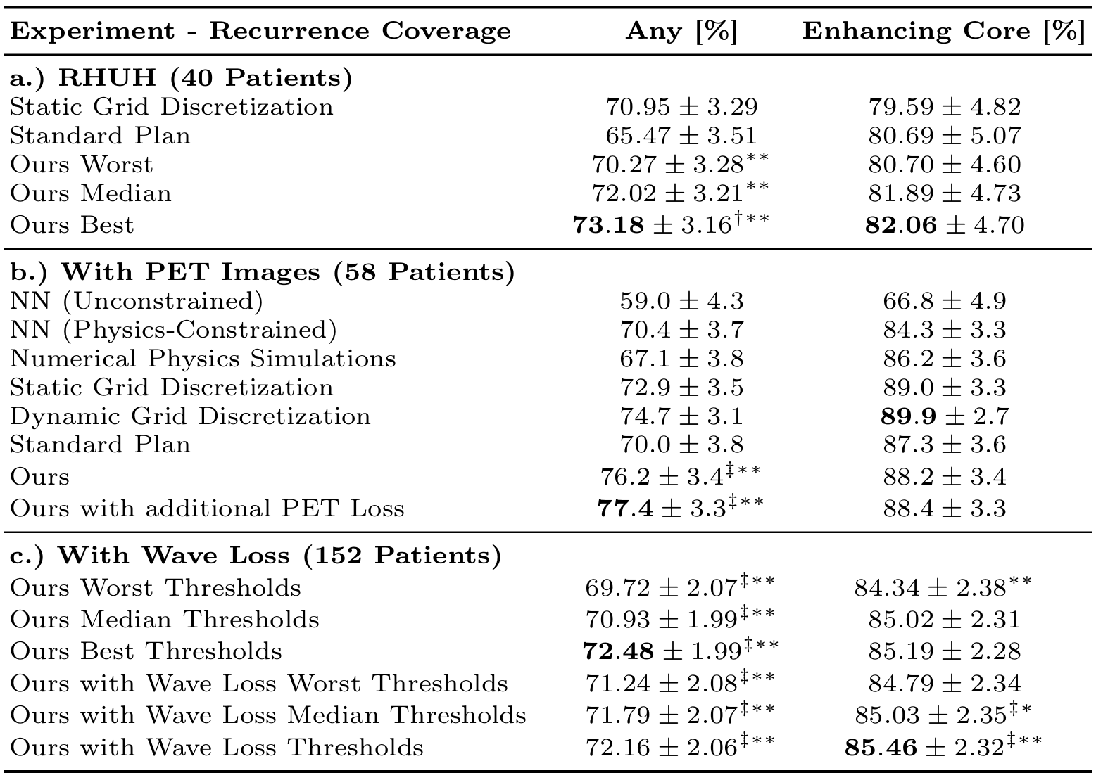
Additional Results
External Dataset
Add FET-PET
Images
Add Wave Loss

Slide 19
Summary: A Lightweight Optimization Framework for Estimating 3D Brain Tumor Infiltration
Improving the clinical target volume is hard
Lightweight optimization
outperforms advanced biophysical modeling
and ML-based approaches
FET-PET imaging helps

Slide 20
Thanks to all my co-authors!
CMMCAWorkshop

